Slide 1
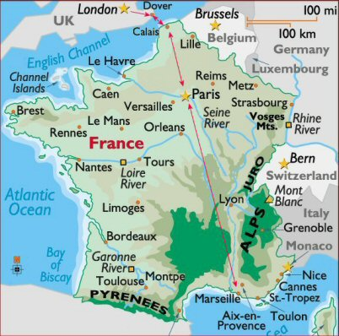
Introduction to A Tale of Two Cities
English 9(1)

Slide 2
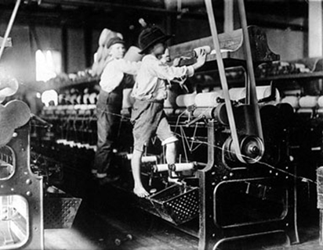
lONDON
Victorian London was the largest, most spectacular city in the world.
While Britain was experiencing
the Industrial Revolution, its capital
was both reaping the benefits and
suffering the consequences.
In 1800 the population of London was around a million souls. That number would swell to 4.5 million by 1880.

Slide 3
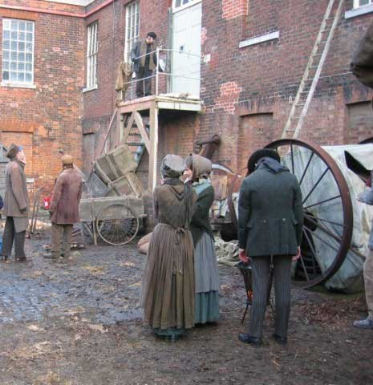
London
The price of this explosive growth and domination of world trade was untold squalor and filth.

Slide 4
London
Dark, circuitous alleys coupled with tall, shadowy buildings and the ever-present shroud of fog made London a criminal's paradise.
Outrageous murders, robberies and assaults of all kinds were commonplace.
There was no organized law enforcement to speak of - the idea of a uniformed policeman patrolling the streets in order to prevent crime was considered too French and an insult to the Englishman's liberty.

Slide 5
London
George III was born on 4 June 1738 in London. He was the first monarch to be born in England and to use English as his first language.
George III is widely remembered for two things: losing the American colonies and going mad.
His wife was Charlotte Sophia .
Both the King and Queen resided at Windsor Castle.

Slide 6
London
This is far from the whole truth. George's direct responsibility for the loss of the colonies is not great. He opposed their bid for independence to the end, but he did not develop the policies.
These policies were largely due to the financial burdens of administering the vast expansion of territory brought under the British Crown in America, the costs of a series of wars with France and Spain in North America, and the loans given to the East India Company. By the 1770s, and at a time when there was no income tax, the national debt required an annual revenue of £4 million to service it.

Slide 7
London
London experienced an increased demand for medical specimens. In desperation, anatomists turned to grave robbery as a means of acquiring bodies for dissection. Initially, these thefts were conducted by anatomists andt heir students, but by the mid-18th century, there arose a class of thieves who made their living from this gruesome practice. These so-called resurrectionists or resurrection men entered graveyards on the night following a funeral. Working silently, with as little light as possible, they unburied the upper part of the coffin in the new grave. After breaking through the lid, they slipped a noose around the corpse's neck and dragged the body. At the anatomy school, they received money for the body, generally with no questions asked.
Thousands of graves were robbed in the late 18th century and early 19th century, primarily in and around Dublin, Edinburgh, Glasgow, and London.

Slide 8
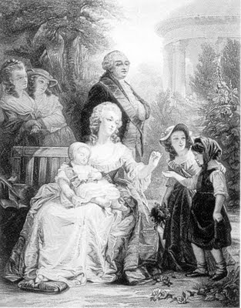
France
France was governed by a king who ruled thanks
to the grace of God; in 1789 this was Louis XVI,
crowned on June 11th 1775.
Marie Antoinette was the queen of France.
Ten thousand people worked in his main palace at Versailles, and 5% of his income was spent supporting it. ( The remainder was supported by taxes paid by the third estate citizens.)
The rest of French society considered itself divided into three groups: the estates.
The First Estate were the clergy.
The Second Estate were the nobility.
The remainder of France, over 99%, formed the Third Estate. The majority were peasants who lived in near poverty.

Slide 9
France
The causes of the French Revolution, which began in 1789, are still debated by historians. Louis XIV had consolidated absolute rule for the French monarchy, and France was governed by the nobility (Monsiegneur's class) and the clergy. The country ran into huge debt due to an archaic system of taxation and the government's financial support of the American Revolution and the Seven Years War.
The Third Estate (commons) proclaimed themselves the National Assembly and took an oath in a tennis court that they would not disband until they had drawn up a constitution.
On July 14, Parisians attacked the Bastille, a symbol of the other two estates (nobility and clergy). The people were mobilized by hunger and fear of retaliation by the nobles and moved to burn down chateaux belonging to noblemen (like Dickens's fictional Monsiegneur's) in what was known as the grande peur ("great fear"). Riots and looting were rampant.

Slide 10
France
France declared war on Austria, and rumors that the king was guilty of treason turned the people against him.
The Republic was declared in 1792, and it became increasingly radicalized until Maximilien Robespierre took control and instituted the Reign of Terror, in which many were guillotined including the king and queen. The Revolution drew to a close with the death by guillotine of Robespierre himself in 1794 and the rise to power of Napoleon.

Slide 11
France
Political Accomplishments
Constitutionalism was accepted
Democracy Declared(It was never really tried, the Dictatorship began in 1799 )
Liberties declared in writing (equality and security were prefered to liberty (1799)
Right to Property declared
It can justly be said that most of the promises made by the Third Estate and contained in the Declaration of the Rights of Man and Citizen were not carried out.

Slide 12
France
ECONOMIC ACCOMPLISHMENTS
Free land was a reality (Only for those with money)
Workers acquired rights (But not to organize or strike)

Slide 13
France
SOCIAL ACCOMPLISHMENTS
Bourgeoisie replaced clergy & nobles (Common man was left out)
Social reforms passed in Legislature (Not applied to "real" life)

Slide 14
France
RELIGIOUS ACCOMPLISHMENTS
France was still Catholic (No religious freedom, strong anti-Protestant & anti-semitic feelings arose)

